Slide 1
sentiment analysis and text mining
Done by:
Huong Le

Slide 2
Summary
1
Data cleaning and preparation
2
Exploratory data analysis
3
Data exploration
4
Data analysis – Sentiment analysis

Slide 3

introduction
Our dataset consists of customer shipping reviews about electronic devices purchased on Amazon.
Business problems that we are trying to solve are:
A great number of customers’ reviews that are not analyzed and taken care.
Limited customer experience on e-commerce website: delayed shipping, limited response and less interactive when shopping online, bad ordering system

Slide 4
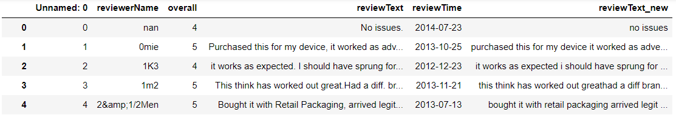
DATA CLEANING AND DATA PREPARATION
Removing punctuation Changing all to lower case

Slide 5
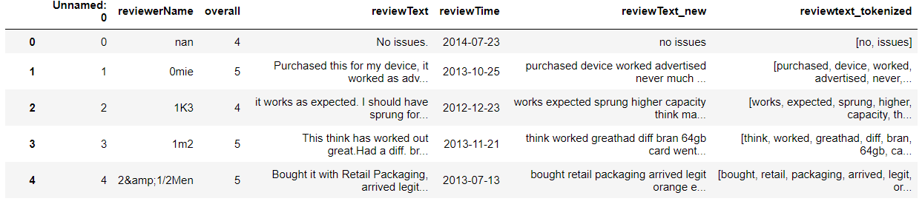
DATA CLEANING AND DATA PREPARATION
Tokenization

Slide 6
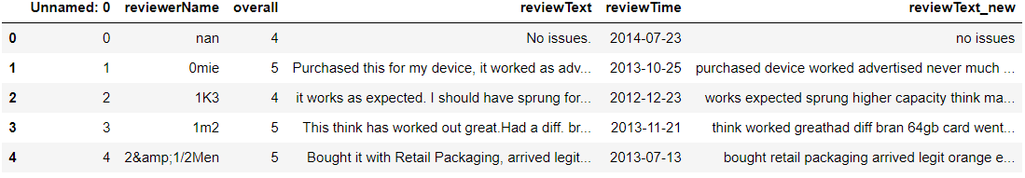
DATA CLEANING AND DATA PREPARATION
Removing stopwords

Slide 7
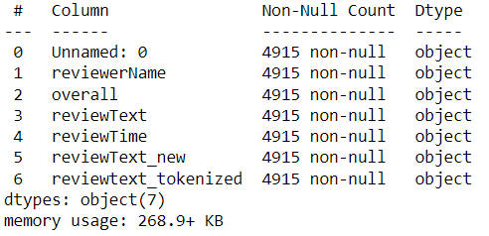
EDA
Simple statistics

Slide 8

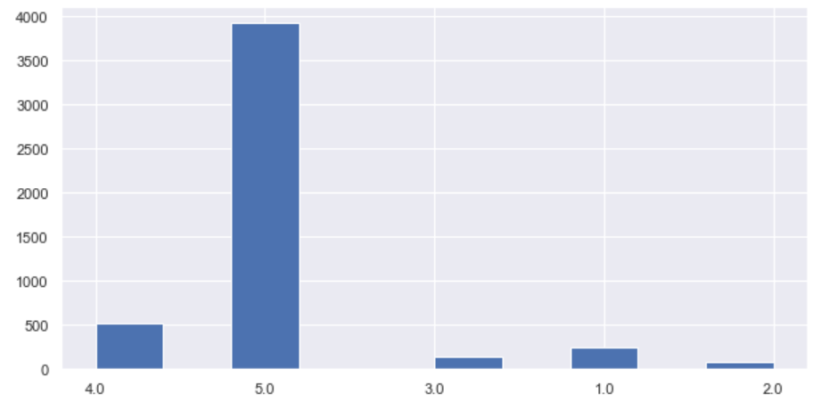
DESCRIPTIVE ANALYSIS – EDA
Shape
Histogram of Overall Rating

Slide 9

DATA EXPLORATION
Creating a word cloud

Slide 10
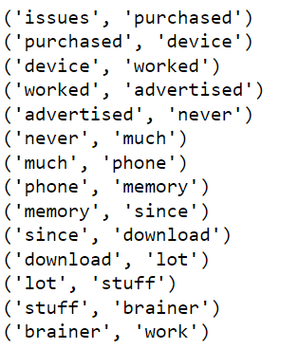
DATA EXPLORATION
Running bigram

Slide 11
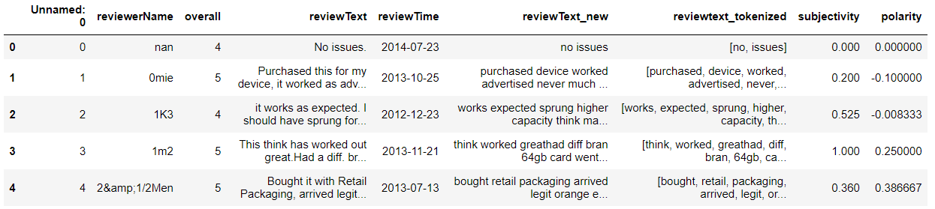
Data analysis – sentiment analysis
Getting subjectivity and polarity

Slide 12
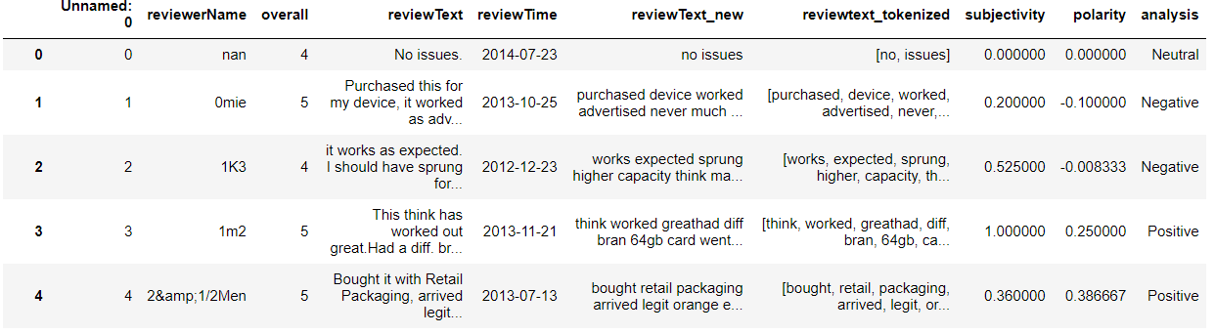
sentiment analysis
Computing negative, neutral and positive analysis

Slide 13

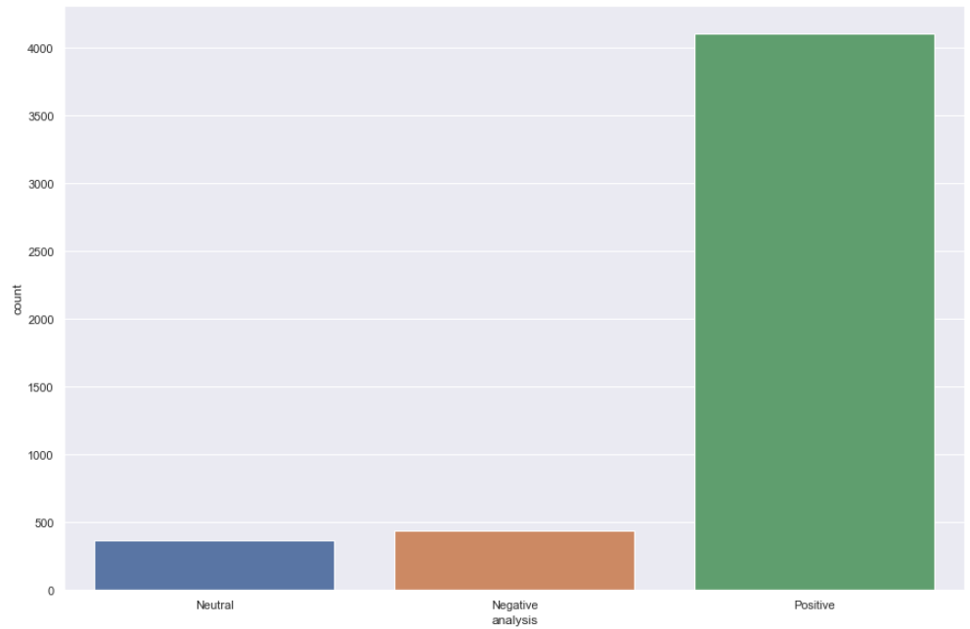
Data analysis – sentiment analysis
Counting polarity
Visualizing polarity

Slide 14
CONCLUSION
1
Actively rank customers’ reviews and resolve any related problems => essential for any e-commerce business
2
Compensate customers if any problem indeed occurred
3
Identify areas of improvement to deliver hassle-free purchasing experience
4
Increase customer satisfaction, customer retention, overall profit and business’ reputation
How business can benefit from our sentiment analysis

Slide 15
THANK YOU

